Slide 1

Using Deep LEARNING TECHINQUES TO IMPORVE OPTICAL CHARACTER Recognition for historical Documents
by Mengyue Zhao
beczhaozmy@gmail.com

Slide 2
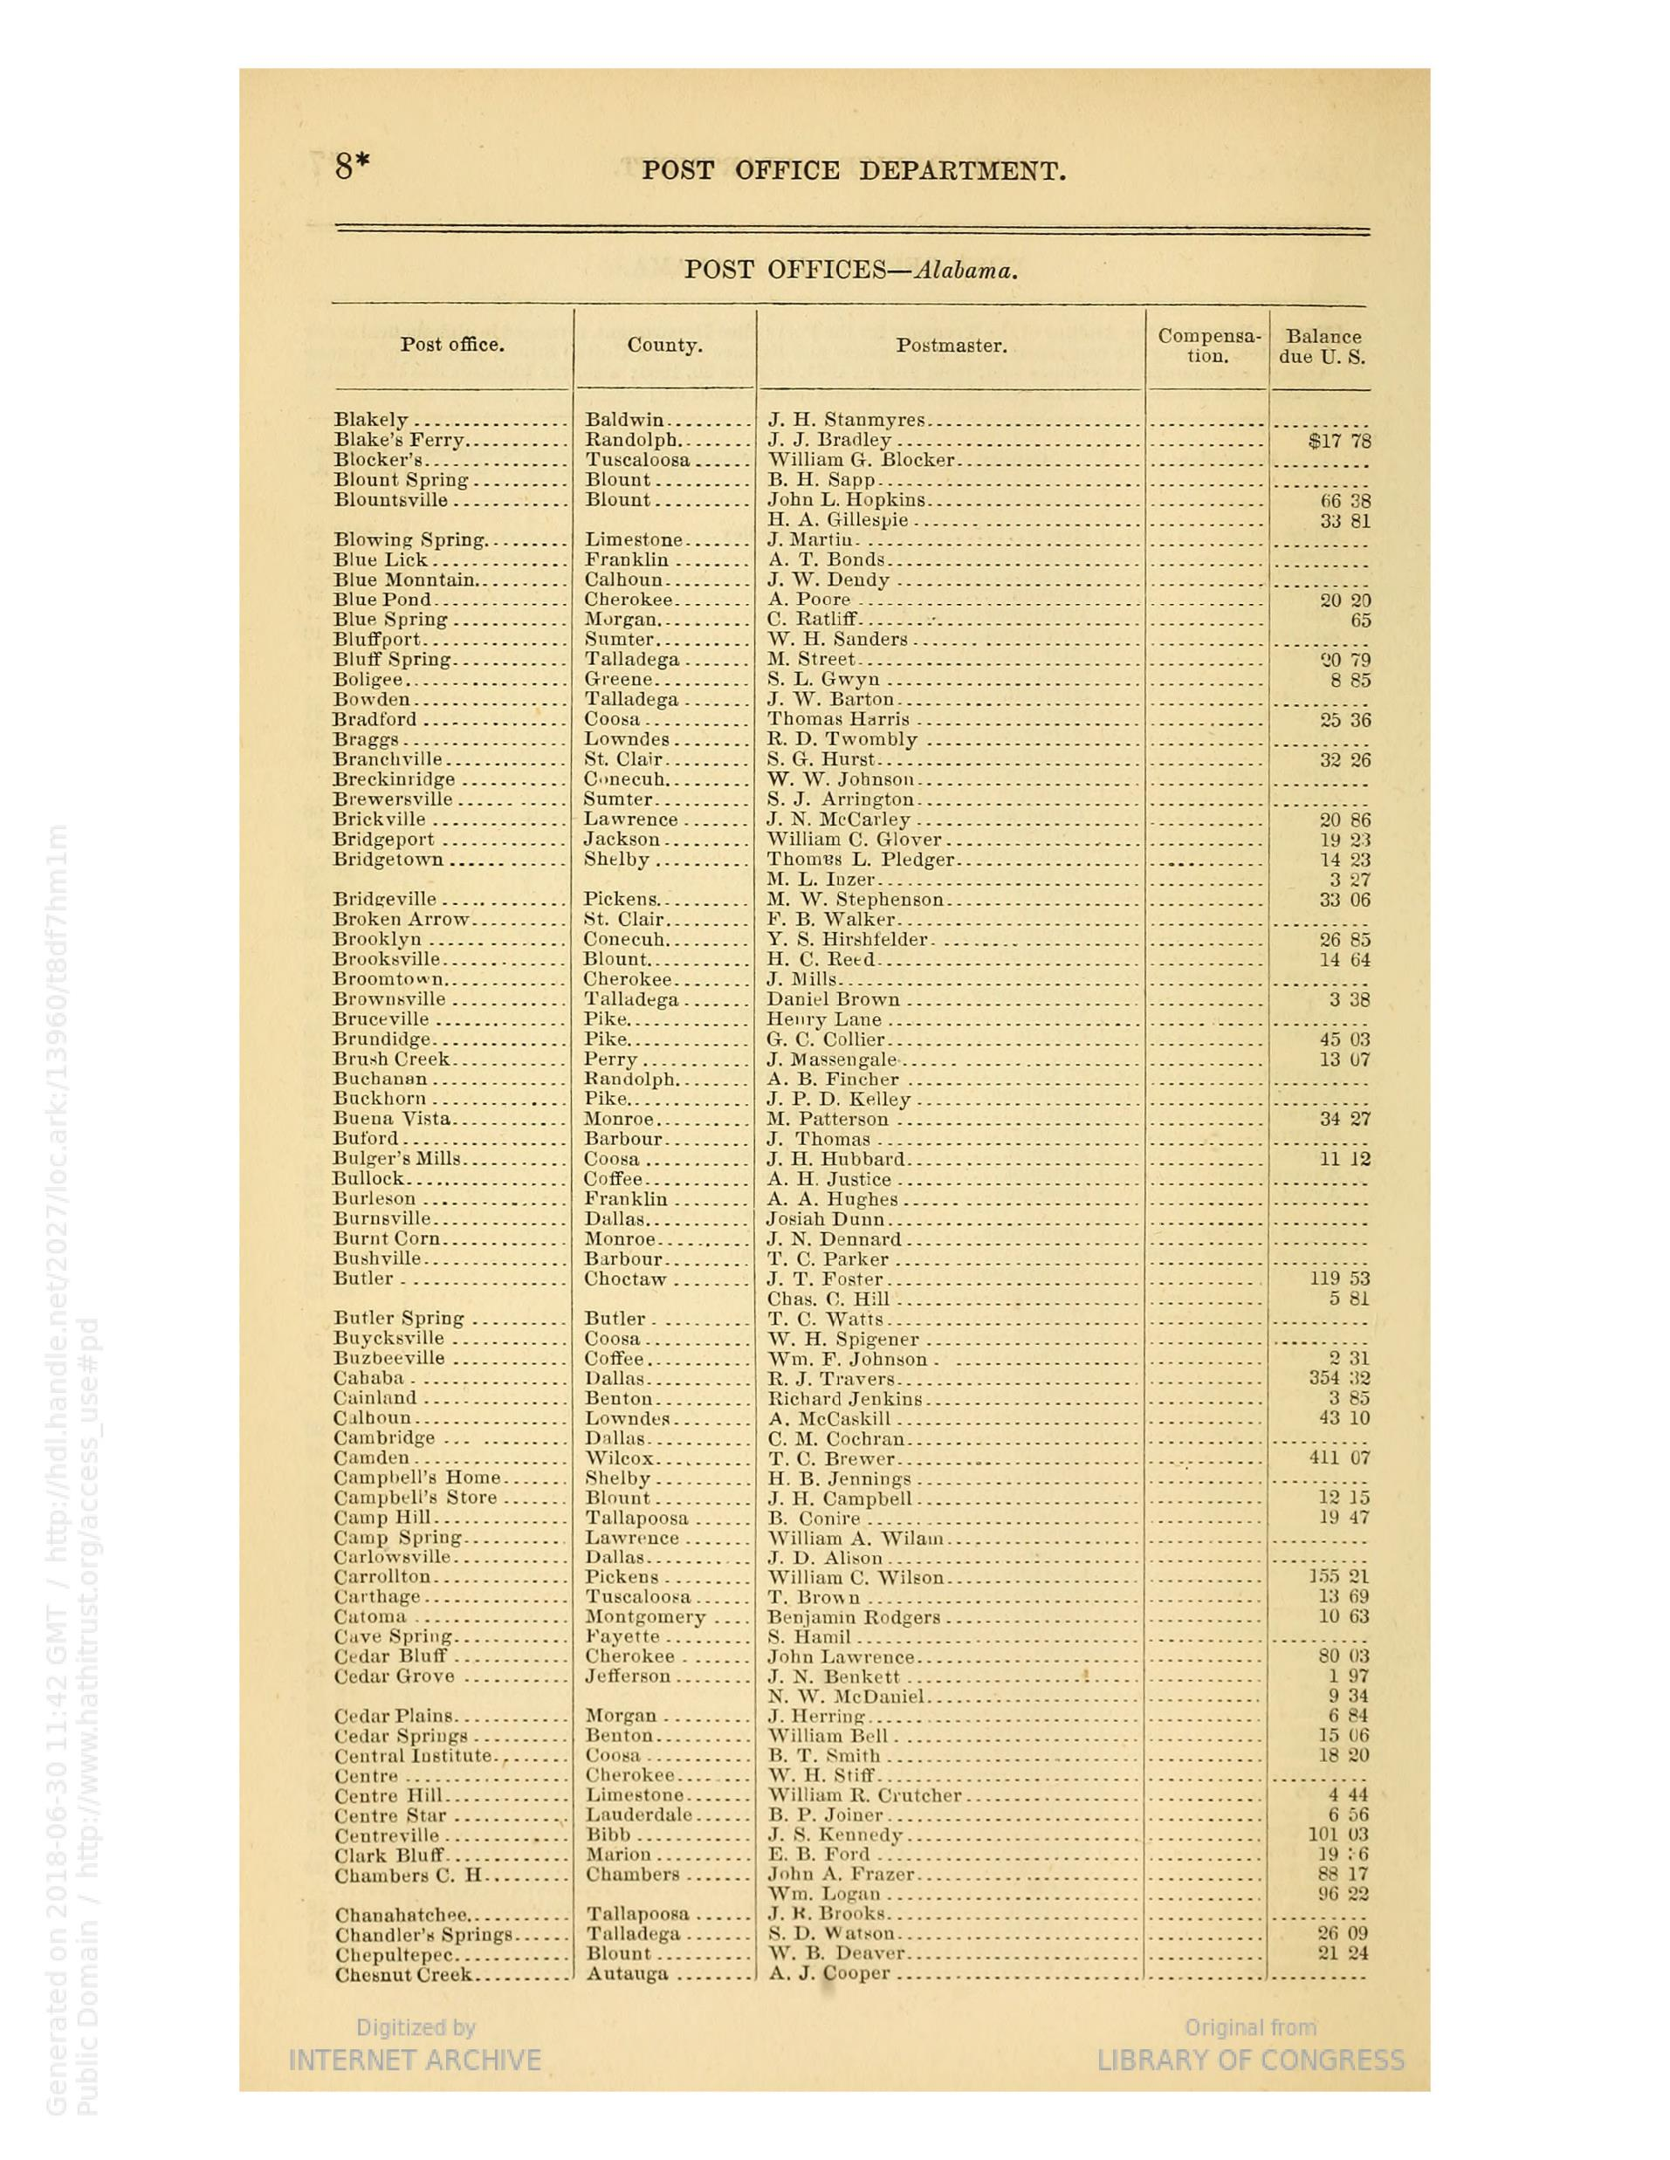
Problem Introduction
Historians have a hard time extracting large amounts of data from raw scans. Especially from historical tables which commercial for which commercial software are not designed.
Linking different historical sources requires very high accuracy of picture-to-data-frame recognition.
I found a very interesting large dataset that requires an improvement on such software. This project is designed to handle tens of thousands of raw scans as shown in the picture on the right side.
The alternative to this solution is manual input by typists, which is costly, inaccurate and often-time yields unknown or stringent mistakes that are hard to correct.

Slide 3
What is Tesseract and how does it work?
Tesseract is an optical character recognition software initially maintained by HP in the 1990s, later open-sourced and now maintained by Google.

Slide 4
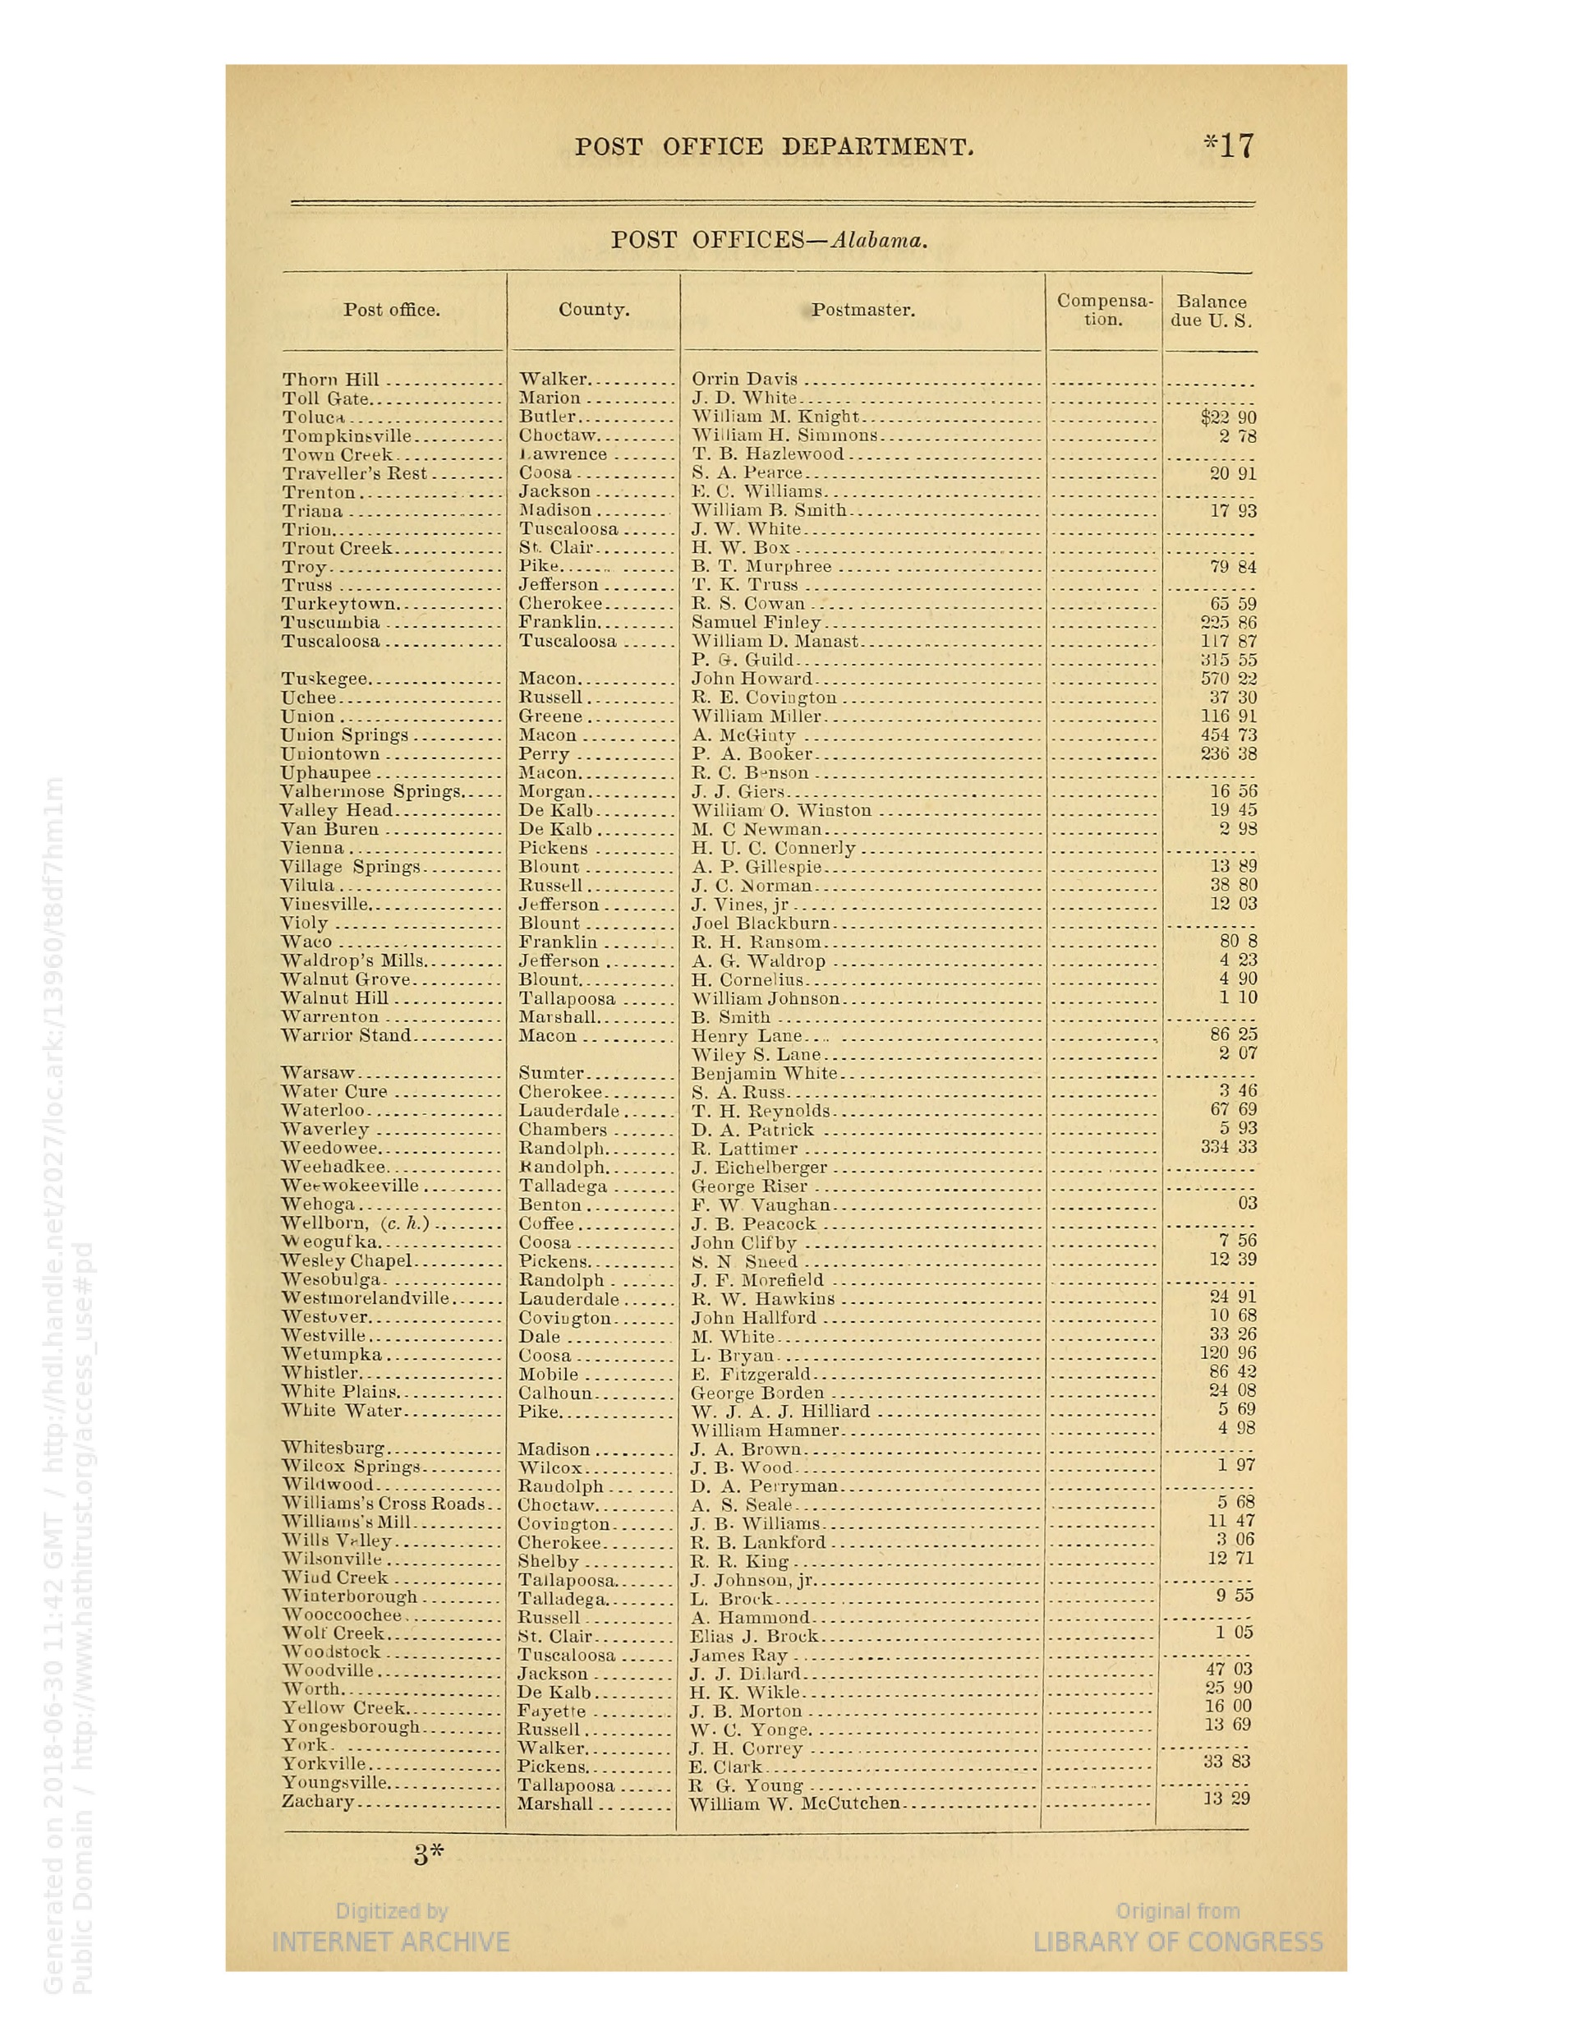
How does Tesseract (or OCR in general) Work?
Page Layout Analysis
Text Line Analysis
Character Segmentation
Optical Character Recognition
(OCR)
Post Processing
Pre-processing

Slide 5
Tesseract Architecture
Connected Component Analysis
Output: Text Lines
Chopping with Character Spacing
Output: Segmented Words
First Pass with a CNN or LSTM
Output: recognized characters, high confidence words are used as training data for the second pass
Second Pass with an Adaptive Classifier Using LSTM or CNN
Output: proposal of prototype words
Linguistic Analysis
Page Layout Analysis*
Output: Text Regions/ Block of Texts
Notes:
Connected component analysis: go through pixels recurrently, label connected pixels the same. Assuming that the picture is binary (1: foreground, 0: background).
Connect Component Analysis: get the median height of the blobs? In the region, filter out blobs that are smaller than a % of the median. Sort blobs by x-coordinates and assign them to lines. > merge blobs horizontally. Use a spline, rather than straight line to fit the baseline.
Chopping: fixed width chopping of characters. For non-fixed width text spacing: Run a word and character classifier > non-satisfactory/ low confidence results > chop the blob with the lowest confidence level by on cave vertices > run character classifier again > discard chopping points that fail to improve confidence level> if the result is still not good > use an associator that connects chopped blobs into candidate characters (this fixes broken characters)
Classifier:
Trainned on non-broken characters only because chopping deals with broken characters already.
Two pass – propose a shortlist of character classes. Create a prototype of different proposals for each feature, choose the prototype with the lowest distance from the characters/ all features of consdieations.
Linguistic analysis- Choose the prototype of word with the lowest distance from the actual feature from Top dictionary word, top numeric word, top upper case word, top chassifier choisce word, etc.
Revisiting:
If classifier has low confidence, then revisit chopping with non-fixed pichtes, try different improvements.

Slide 6
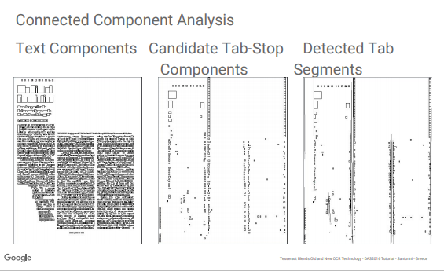
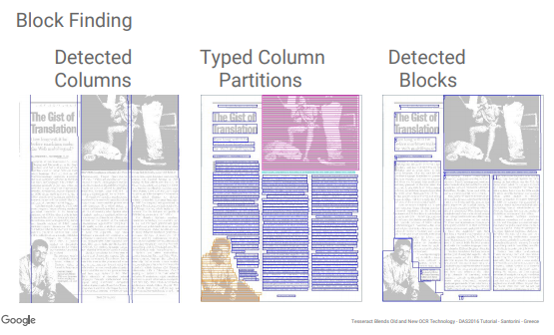
Page Layout Analysis
Bottom-up Approach
Top-down Approach
Connected Component Analysis on pixels
Morphological transformation
Combine regions where possible
Proposed Page Layout
(pre-trained model)
Cut Images into the proposed parts
Validate with Confidence Level

Slide 7
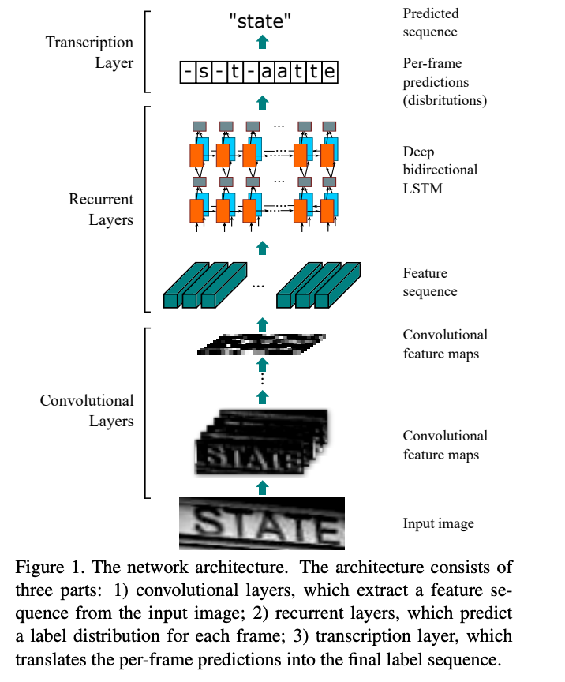
Using LSTM in OCR
Notes:
https://nanonets.com/blog/deep-learning-ocr/
Convolutional layers extract features and pass them into a bidirectional LSTM, which takes into account what comes before and after the character.
Transcription- with LM (Language Model):
Non-lexicon speech/ word recognition (non-vocabulary based)
Use character as features, assign a probability to a sequence of characters. (“word” vs “werd”)
Lexicon word transcription:
- The feature is word, rather than characters. (“this is a dog”, vs “this is a asdfaslkdjfhqw”)
Transcribe text blob to a word based on the preceding and succeeding word, rather than characters.
LM https://towardsdatascience.com/language-models-1a08779b8e12

Slide 8
Links
Visualized Tesseract Architecture
https://limitlessdatascience.wordpress.com/2019/07/01/tesseract-4-0-intro-installation/
How does Tesseract use LSTM
https://github.com/tesseract-ocr/docs/blob/master/das_tutorial2016/6ModernizationEfforts.pdf\
https://nanonets.com/blog/ocr-with-tesseract/
How LSTM work for OCR
https://towardsdatascience.com/a-gentle-introduction-to-ocr-ee1469a201aa

Slide 9
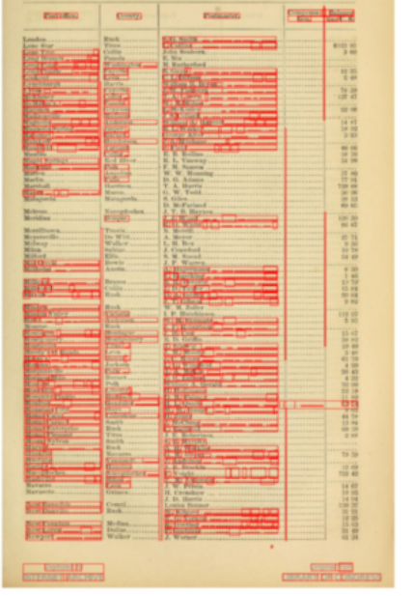
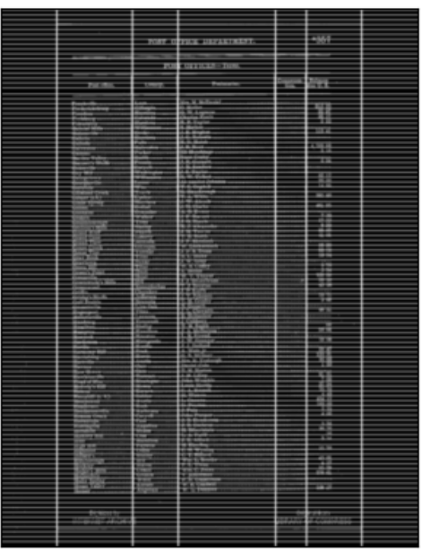
Page Segmentation Solutions
Left: Tesseract Segmentation Results
Right: CV Morphological Transformations

Slide 10
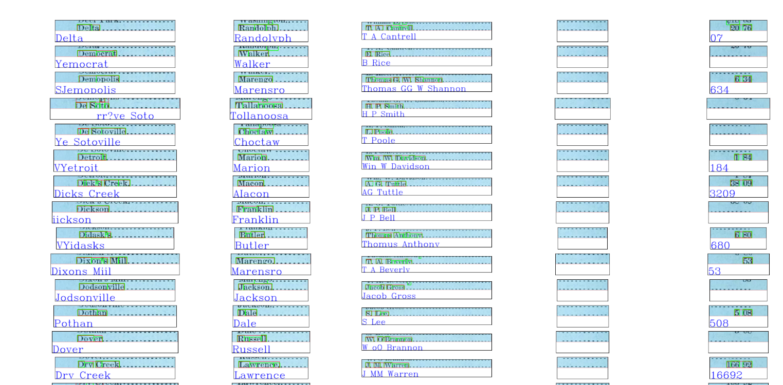
OCR Results

Slide 11
Proposed Solutions
Customized Preprocessing [done]
Page Layout Analysis with Morphological Transformation [done]
Page Segmentation with Morphological Transformation [done]
Fixed-width Character Segmentation [tuning]
Retrain Neural Network on Specific Fonts [done]
Restrained Classifier with a Customized Dictionary (word list) [doing]
Restricted Output Base [done]
Post Processing [doing]
Notes:
Word list:
https://stackoverflow.com/questions/33268289/tesseract-ocr-dictionary-matching
https://vovaprivalov.medium.com/tesseract-ocr-tips-custom-dictionary-to-improve-ocr-d2b9cd17850b

Slide 12
Training Tesseract
Data Preparation
Unicharset
Ground truth file
Image
Box File
*Training for a new font
Training
Generate new trained data
Learning rate, max iterations, target error rate, etc...
Model Evaluation
Model check point (best model from training)
Append best model on new training data to the previous best model
Get and Visualize CER and WER
Training
Notes:
Unicharset - systutorials.com/docs/linux/man/5-unicharset/#:~:text=Tesseract's%20unicharset%20file%20contains%20information,Tesseract%20language%20pack%20(i.e.%20eng.&text=The%20first%20line%20of%20a,of%20unichars%20in%20the%20file.

Slide 13
Unique Character Set
systutorials.com/docs/linux/man/5-unicharset/#:~:text=Tesseract's%20unicharset%20file%20contains%20information,Tesseract%20language%20pack%20(i.e.%20eng.&text=The%20first%20line%20of%20a,of%20unichars%20in%20the%20file.

Slide 14
How does Tesseract’s deep learning engine (LSTM) work?
Trainned data, box file, ground truth.

Slide 15
How does Tesseract Perform on the documents?
Poor Segmentation because of a lack of row boundaries and noises.
Potentially poor character segmentation.
- Poor Model Accuracy for specific fonts (“Times New Roman”)

Slide 16
Model Evaluation Metrics
CER – Character Error Rate
WER – Word Error Rate
The default error rate by tesseract on Times New Roman is CER = 0.14% and WER = 0.57%.

Slide 17

How does Tesseract Perform on the documents?

Slide 18
Plan
Use real test pages and gt on tesseract engine. Generate test results.
Understand the property of tesseract character segmentation.
Learn CNN and LSTM for OCR.

Slide 19
Proposed Solutions
Page Layout Analysis
1. Page Layout Detection
2. Customized Page Segmentation
3. Customized Character Segmentation
OCR
1. Increase Preference in Finding Dictionary Words
NLP Post Process
1. Simple Fuzzy Matching (Matching Efficiency increased by a hash table, etc.)
2. Build a classifier that classify preferentially according to dictionary content.
2. Limit Output Base According to Column Content
Notes:
OCR
1. Increase Preference in finding dictionary words.
Perhaps building a single classifier for each column based on preferred dictionary (first name, last name, state, county, State), for geographical names it should be very useful.

Slide 20
Proposed Solutions
Page Layout Analysis
1. Page Layout Detection
2. Customized Page Segmentation
3. Improve Character Segmentation
OCR
Increase Preference in Finding Dictionary Words
Perhaps building a single classifier for each column based on preferred dictionary (first name, last name, state, county, State), for geographical names it should be very useful.
Limit Output Base According to Column Content
NLP Post Process
Simple Fuzzy Matching (Matching Efficiency increased by a hash table, etc.)
Build a classifier that classify preferentially according to dictionary content.
Notes:
Increase Preference in Finding Dictionary Words
https://stackoverflow.com/questions/40127994/how-to-give-tesseract-a-word-list-net-wrapper/41229275

